Slide 1
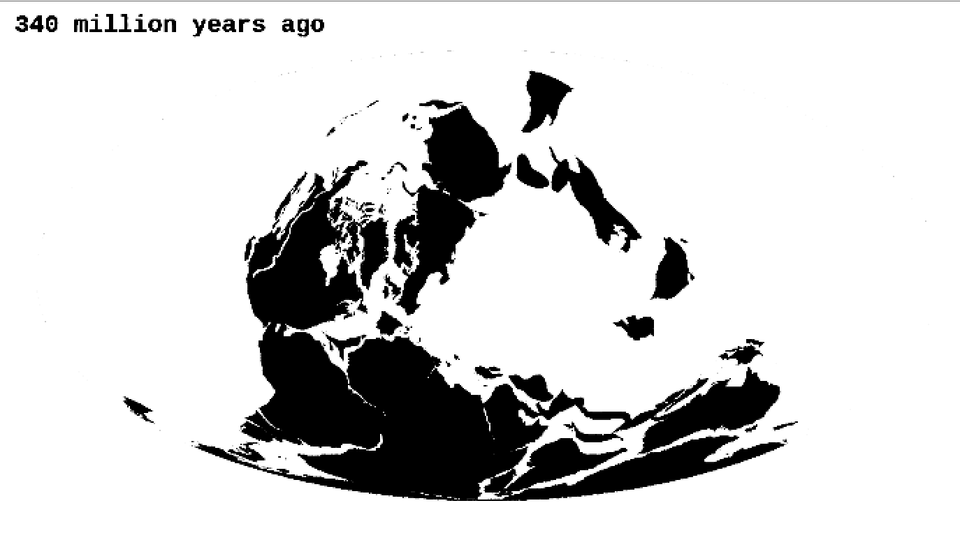
✄
Paleogeography – 340 Ma
map from https://www.axios.com/supercontinent-breakup-drove-evolution-2407903317.html

Slide 2
✄
⠠⠏⠁⠇⠑⠕⠛⠑⠕⠛⠗⠁⠏⠓⠽⠀⠤⠀⠼⠉⠙⠚⠀⠠⠍⠁

Slide 3
✄

